Slide 1



Azure Developer College Day 6 Containerization
Özgür Öztürk
Cloud Solution Architect
Microsoft Deutschland GmbH
ozgurozturknet

Slide 2
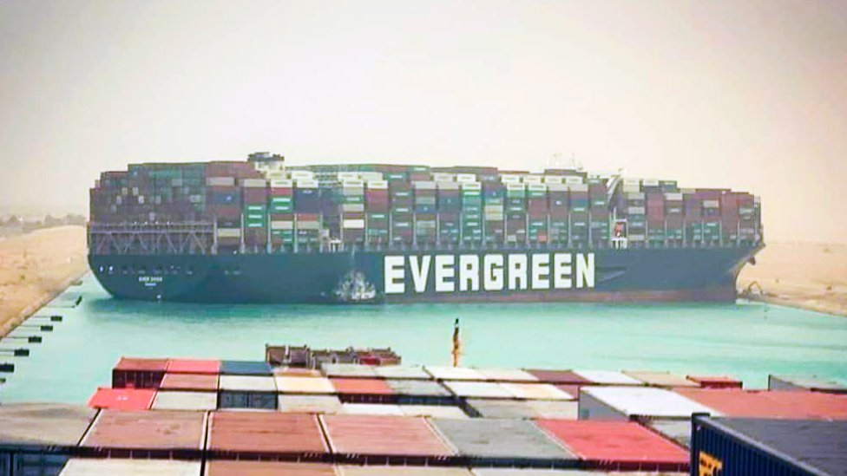

Slide 3

Agenda of the Day
09:00 - 09:45 [Docker 101] 45 min
09:45 - 10:15 [Challenge 1: Docker 101] 30 min
10:15 - 10:30 [Break] 15 min
10:30 - 11:30 [Container 101] 60 min
11:30 - 12:00 [Challenge 2: Container 101] 30 min
12:00 - 13:00 [Lunch Break] 60 min
13:00 - 13:45 [Docker Objects] 45 min
13:45 - 14:15 [Challenge 3: Docker Objects] 30 min
14:15 - 14:30 [Break] 15 Min
14:30 - 15:30 [Image and Registry] 60 min
15:30 - 16:00 [Challenge 4: Image and Registry] 30 min
16:00 - 16:30 [Azure Container Services] 30 min
16:30 - 17:00 [Challenge 5: Azure Container Services] 30 min
Docker 101
Container 101
Docker Objects
Image and Registry
Azure Container Services

Slide 4

Docker 101

Slide 5



app1
app2
app1
app2
hypervisor

Slide 6
Waste of Resources
app1
app2
app3
app4
app5
app6
%5
%5
%5
%5
%5
%5
hypervisor
%30

Slide 7
Container
app1
app2
namespaces
control groups

Slide 8
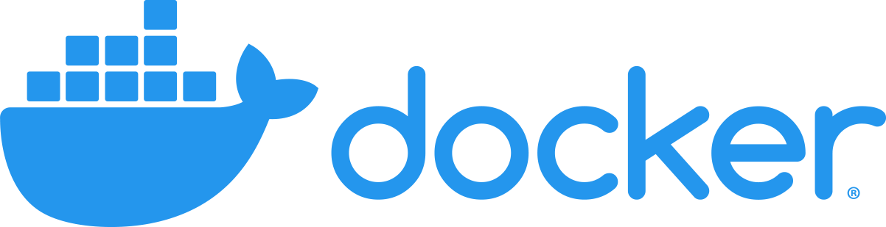

Slide 9

Docker
Docker container technology was launched in 2013 as an open source Docker Engine.
It leveraged existing computing concepts around containers and specifically in the Linux world, primitives known as cgroups and namespaces. Docker's technology is unique because it focuses on the requirements of developers and systems operators to separate application dependencies from infrastructure.
Success in the Linux world drove a partnership with Microsoft that brought Docker containers and its functionality to Windows Server (sometimes referred to as Docker Windows containers).
Technology available from Docker and its open source project, Moby has been leveraged by all major data center vendors and cloud providers. Many of these providers are leveraging Docker for their container-native IaaS offerings. Additionally, the leading open source serverless frameworks utilize Docker container technology.

Slide 10

Docker
Docker Daemon
Docker Rest API
Docker CLI

Slide 11
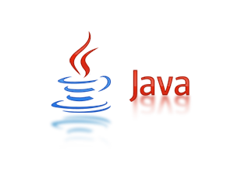

Image
Image
app1
kernel
applications

Slide 12
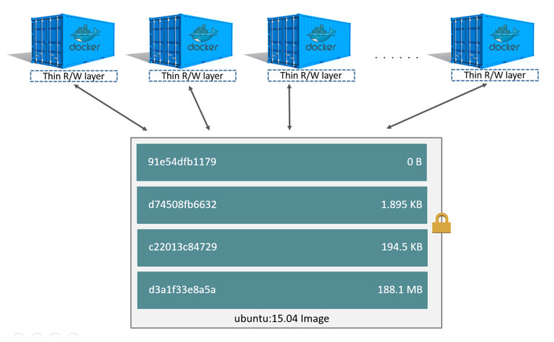
Container

Slide 13
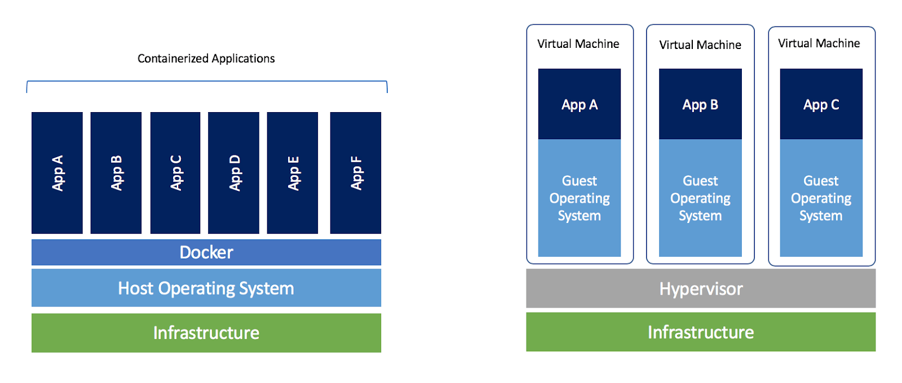
Container vs. Vm

Slide 14
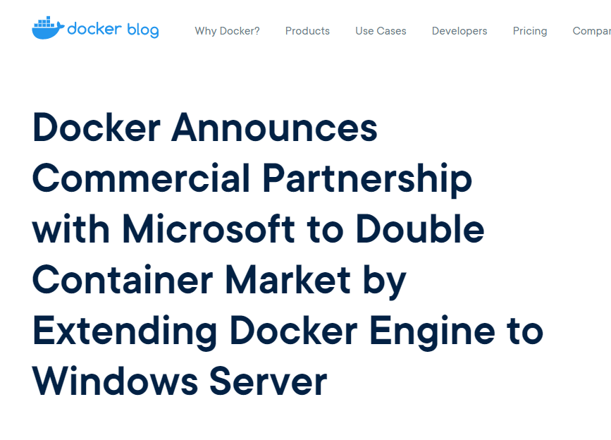
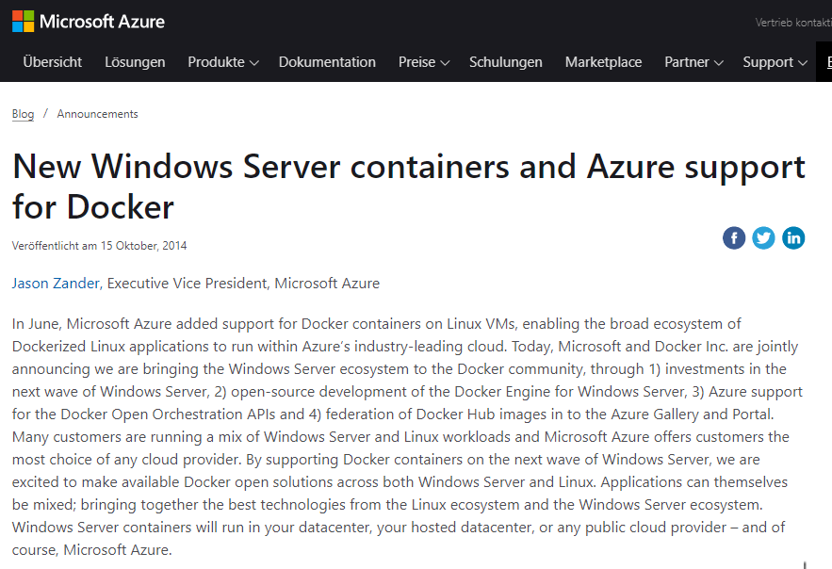
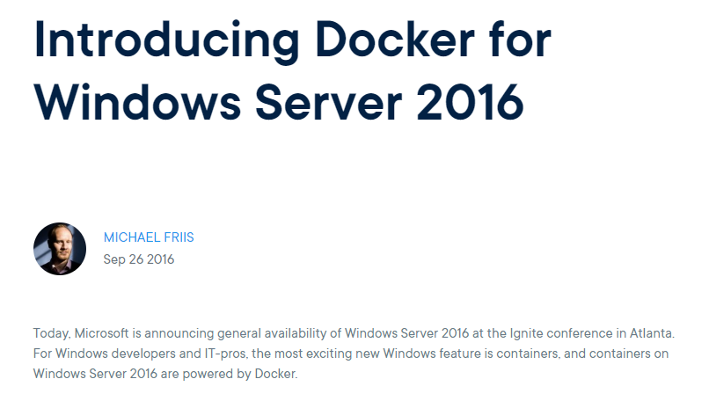
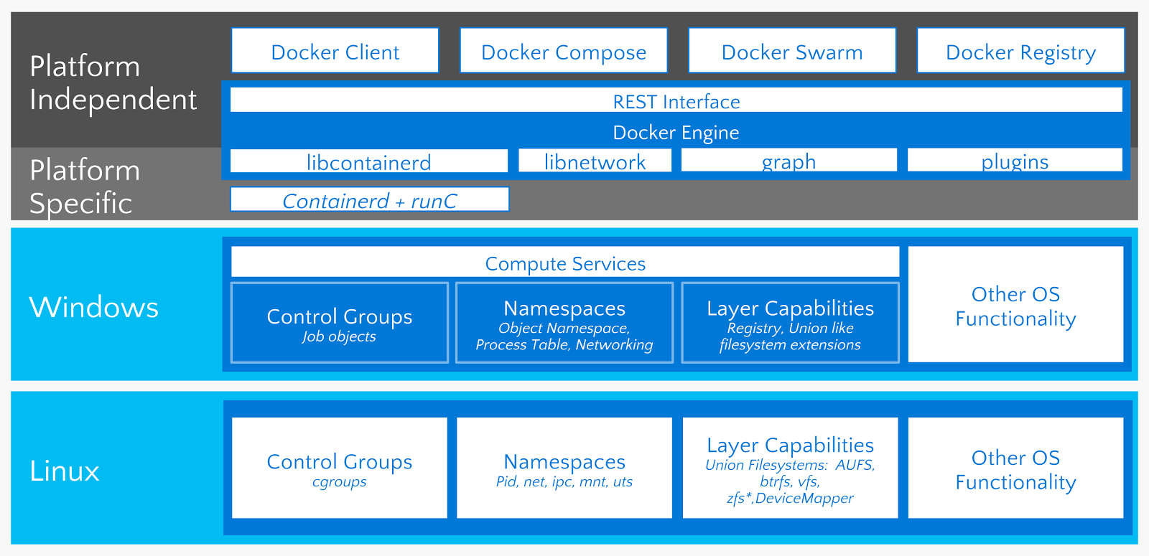
Native Windows Container

Slide 15
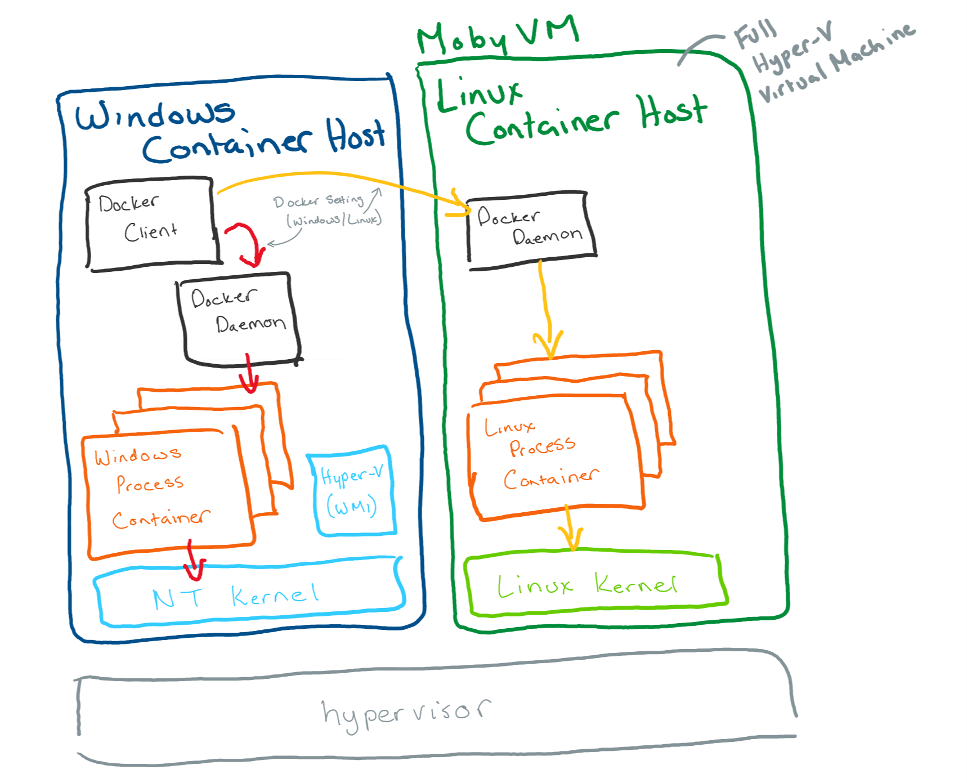
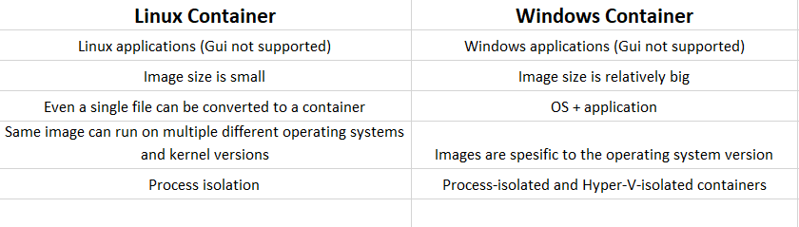
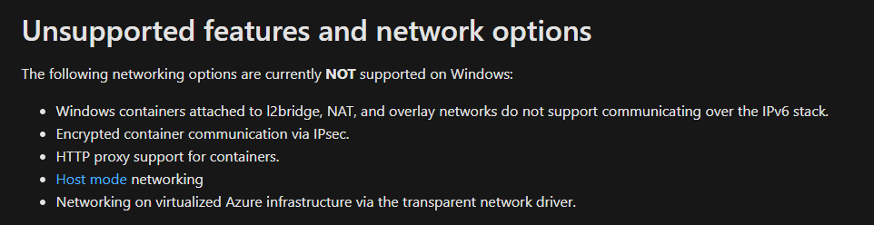
What's the difference between Linux and Windows Server containers?
Linux and Windows Server both implement similar technologies within their kernel and core operating systems. The difference comes from the platform and workloads that run within the containers.

Slide 16
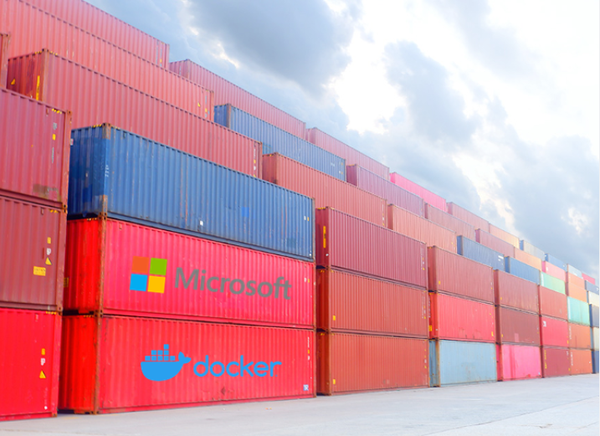
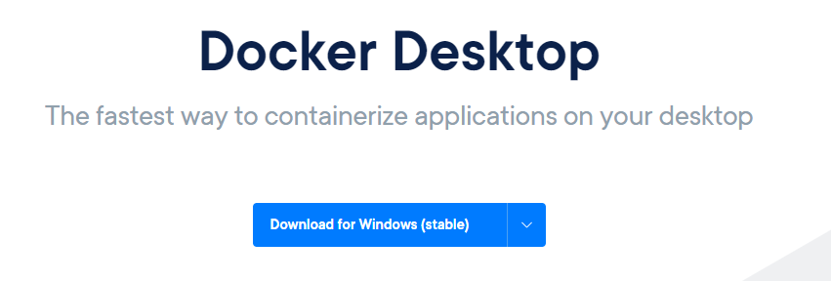
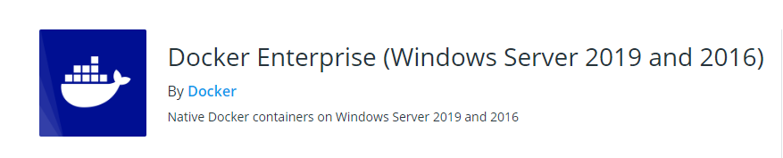
Supported platform
Test, development → Windows 10 Pro-Ent
Production → Windows Server 2016, 2019 (ltsc)
* Docker Enterprise (Windows Server) is available at no additional cost to all Windows Server 2019 and 2016 customers. Technical support is aligned to the Microsoft support entitlement and provided by Microsoft.

Slide 17
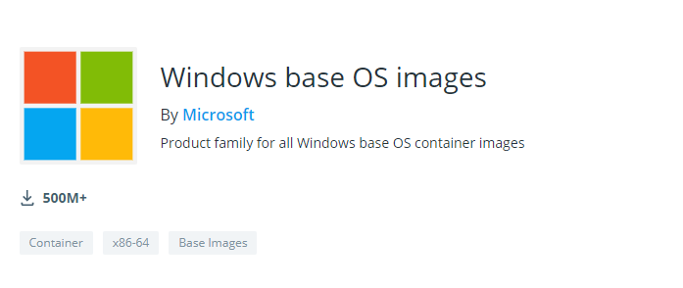
Base Images
Windows
contains the full set of Windows APIs and system services (minus server roles).
mcr.microsoft.com/windows
Windows Server Core
a smaller image that contains a subset of the Windows Server APIs–namely the full .NET framework. It also includes most server roles, though sadly to few, not Fax Server.
mcr.microsoft.com/windows/servercore
Nano Server
the smallest Windows Server image, with support for the .NET Core APIs and some server roles.
mcr.microsoft.com/windows/nanoserver
Windows IoT Core
a version of Windows used by hardware manufacturers for small Internet of Things devices that run ARM or x86/x64 processor
mcr.microsoft.com/windows/iotcore
←Provides the full Windows Api set
←Supports Traditional .Net Framework Applications
←Built for .Net Core Applications
←Purpose-built for IoT applications

Slide 18
Microsoft Managed Purpose build Images
Do you want to use a .Net Framework or .Net Core-based application or IIS for a web application?
Then don't waste time by creating your .net sdk image top of the Server Core.
Microsoft publishes both .Net Framework and .Net Core basic images (both SDK and Runtime). Instead of creating your own .net images from scratch, always use these dotnet basic images.
.NET Framework
- .NET Framework SDK | https://hub.docker.com/_/microsoft-dotnet-framework-sdk/
- .NET Framework Runtime | https://hub.docker.com/_/microsoft-dotnet-framework-runtime/
- ASP.NET Web Forms and MVC | https://hub.docker.com/_/microsoft-dotnet-framework-aspnet/
- Windows Communication Foundation (WCF) | https://hub.docker.com/_/microsoft-dotnet-framework-wcf/
.NET Core:
- .NET Core SDK | https://hub.docker.com/_/microsoft-dotnet-core-sdk/
- .NET Core Runtime | https://hub.docker.com/_/microsoft-dotnet-core/
- ASP.NET Core Runtime | https://hub.docker.com/_/microsoft-dotnet-core-aspnet/
IIS
- Server Core IIS | https://hub.docker.com/_/microsoft-windows-servercore-iis

Slide 19
_
Demo>
Docker 101

Slide 20
Challenge 1: Docker 101
>
_
github.com/azuredevcollege/trainingdays/-> day6 -> Challenge 1

Slide 21
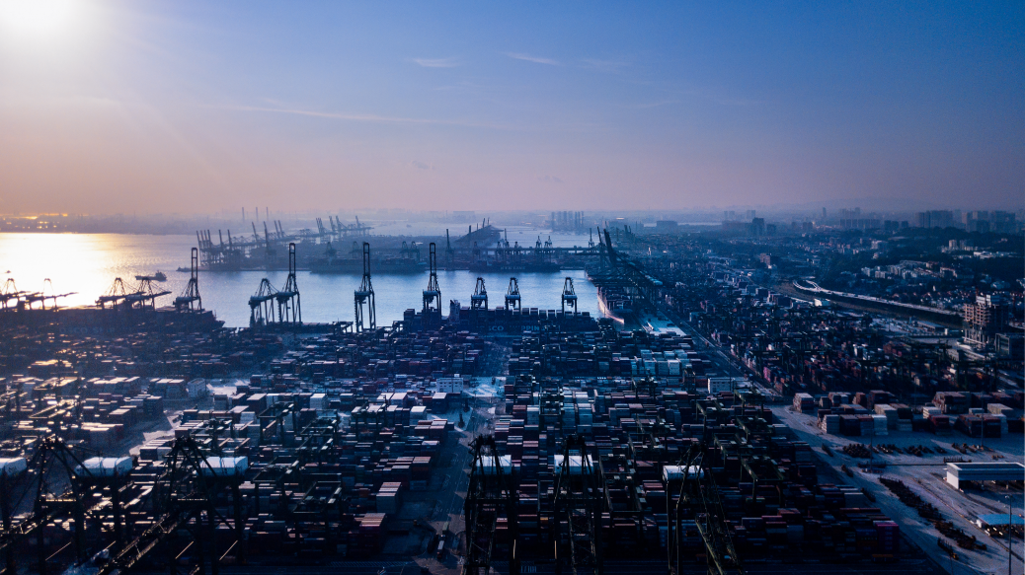
Container 101

Slide 22


Pre-container era
webserver1
Manage
Update
Back-up
Maintain
Continuous operation for the longest time possible
index.html

Slide 23
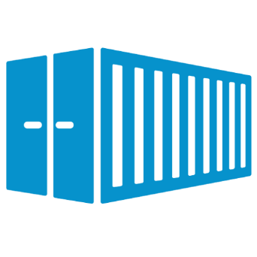
Container era
7ad0fbf3eda2
container
Designed for a single application to run
All adjustments are handled on the image level.
Disposable
It is easy to create a new container in seconds when there is a problem
The problems are not solved by connecting to the container. A new image is built and a new container from that image is created

Slide 24
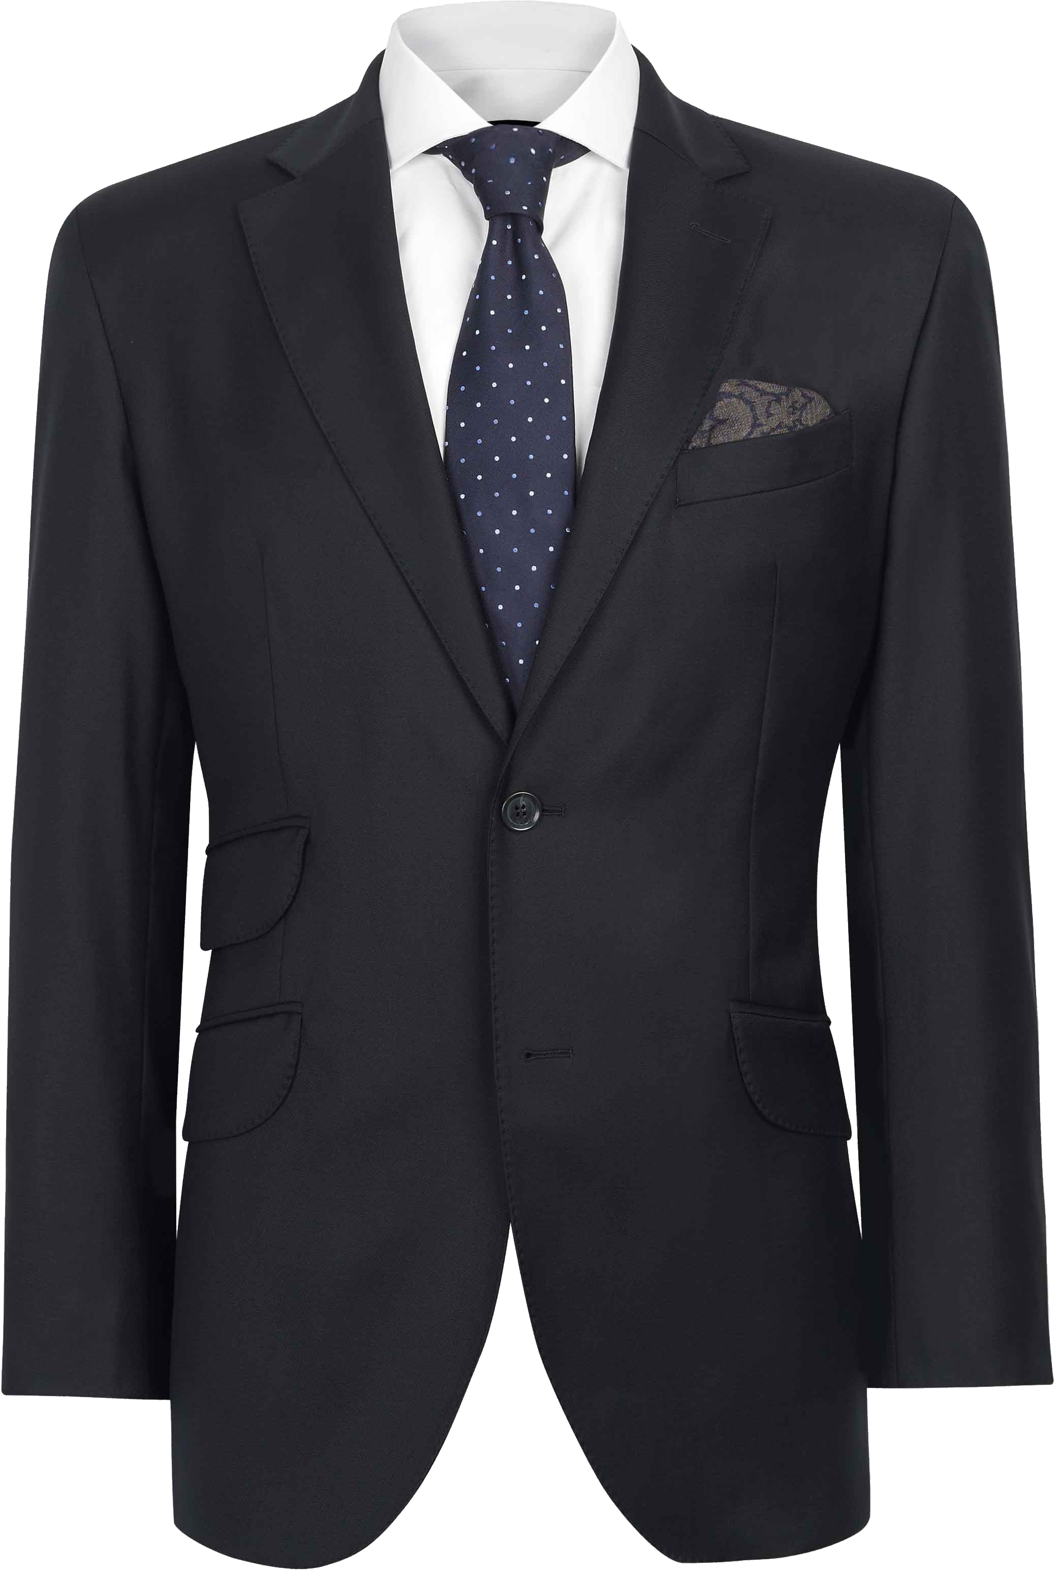
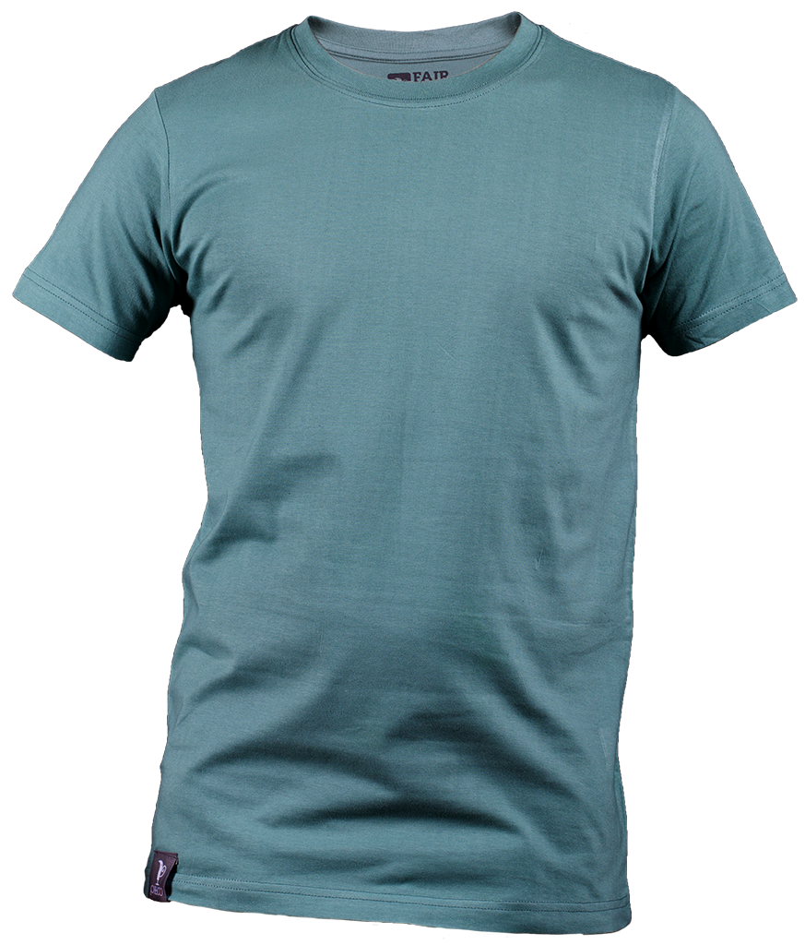
New approach
Old Way (Servers)
New way (Containers)

Slide 25
Summary
1: Containers are built to run single application. (One application per container)
2: Containers are created from objects that we call image, where all the requirements for this single application to be prepared in advance. All these container-related requirements are expected to be completed at the image level.
3: Containers are disposable, and images are immutable.
4: If there is a problem in the container, this is not solved by connecting to the container. The container is stopped, and a new container is created from scratch. If the problem is related to settings or config, the problem is solved by creating a new image with fixed files in it and a new container is created by that new image.

Slide 26
Union File System
Writable layer of Container
/bin /etc /lib /mnt /opt /root /sbin /sys /usr /dev /media /proc /run /srv /tmp /app/app1.java /test/
a.txt
a.txt
Image
(Read-only Layers)
app1:latest
Notes:
%

Slide 27
2 containers from the same image
container1
container2
app1:latest
Docker Image

Slide 28
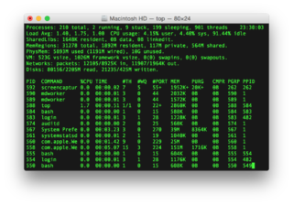
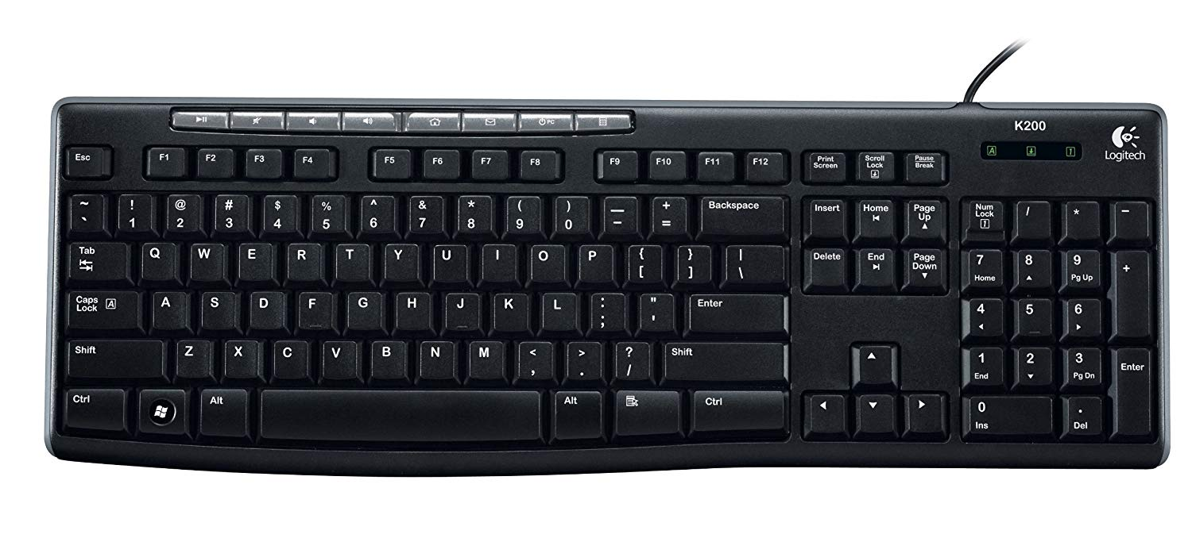
Standard Input-Output-Error
Terminal
stdout (1)
Process
stdin (0)
stderr (2)

Slide 29
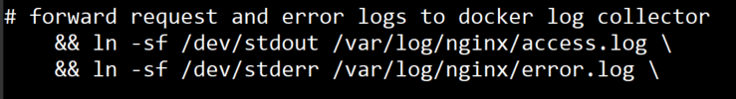
docker logs
docker logs container_id-or-container_name
i.e: docker logs 207adb2b63
Options:
--details Show extra details provided to logs
-f, --follow Follow log output
--since string Show logs since timestamp (e.g.
2013-01-02T13:23:37) or relative (e.g. 42m for 42
minutes)
--tail string Number of lines to show from the end of the logs
(default "all")
-t, --timestamps Show timestamps
--until string Show logs before a timestamp (e.g.
2013-01-02T13:23:37) or relative (e.g. 42m for 42
minutes)

Slide 30
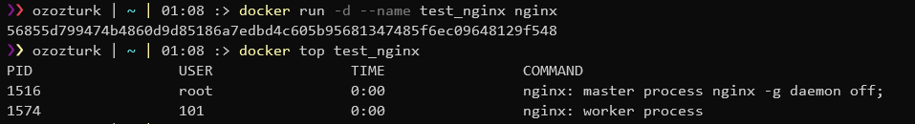
docker top
docker top container_id-or-container_name
i.e: docker top 207adb2b63

Slide 31
docker stats
docker stats #all running containers
docker stats container_id-or-container_name
i.e: docker stats 207adb2b63

Slide 32
Cpu and Memory limits
--memory=
--memory-swap
--cpus=
--cpuset-cpus=

Slide 33
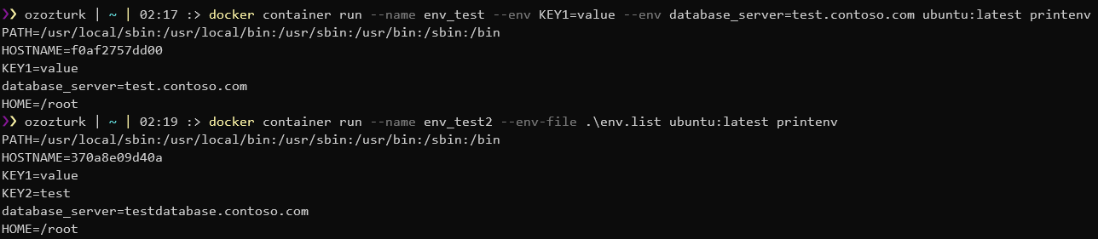
Environment Variable
--env KEY=Value
--env-file file

Slide 34
Challenge 2: Container 101
>
_
github.com/azuredevcollege/trainingdays/-> day6 -> Challenge 2

Slide 35
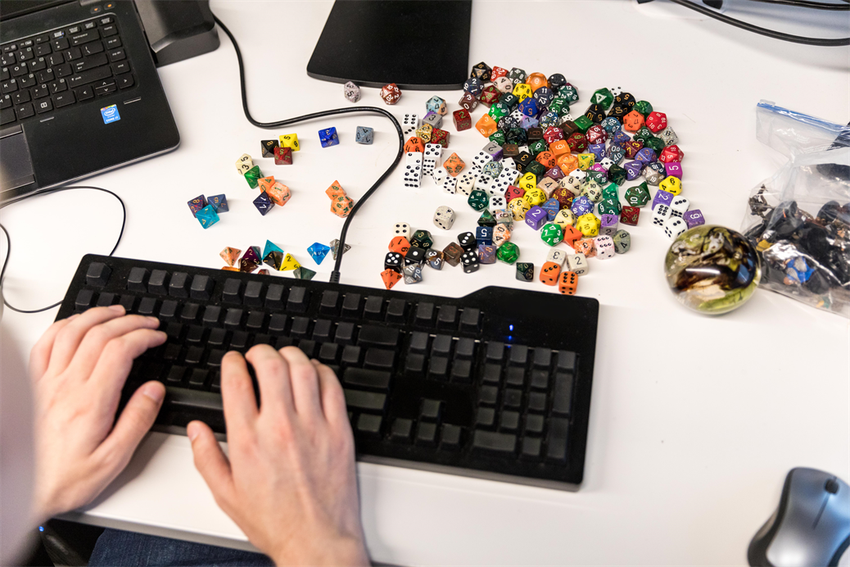
Docker Objects

Slide 36
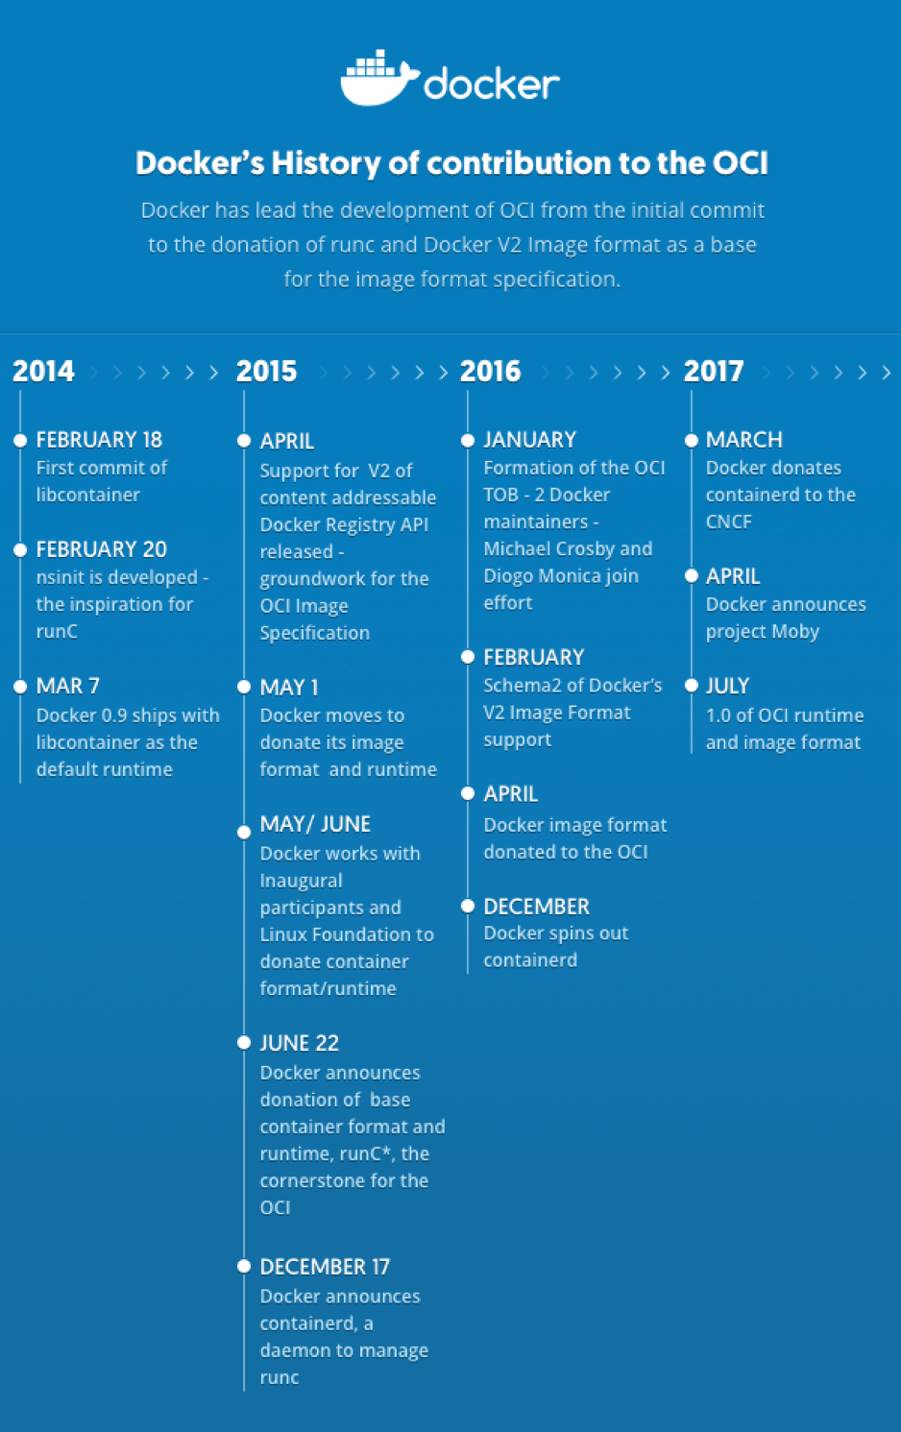
Docker Evolution
Docker has changed from the first apprentice to today and has evolved continuously

Slide 37
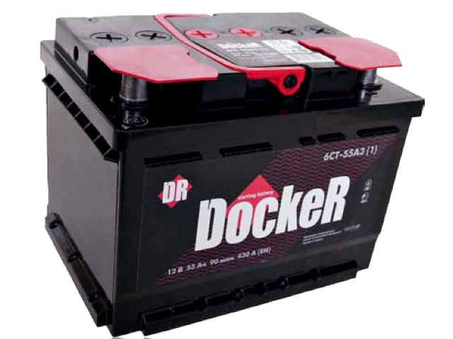
Batteries Included but Removable
Docker’s design motto

Slide 38
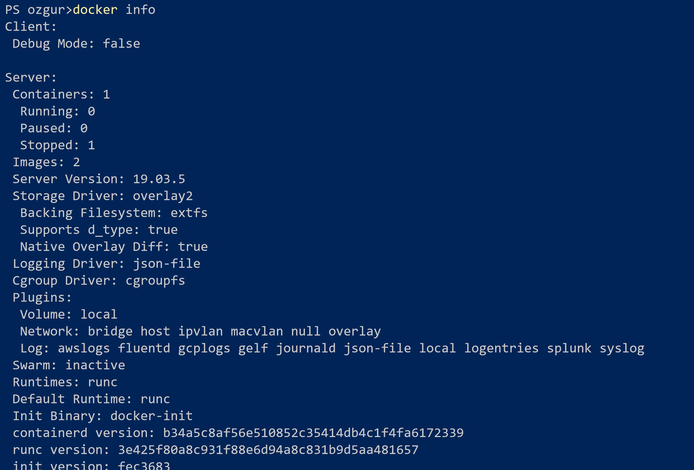

Slide 39
Data written in the container
container1
367864
373872
137449
283489
987489
RW Layer
app.log
app1:latest
container2
RW Layer
app.log

Slide 40

Volume
docker host
/bin /etc /lib /mnt /opt /root /sbin /sys /usr /dev /media /proc /run /srv /tmp
/app
volume
container
Notes:
%

Slide 41
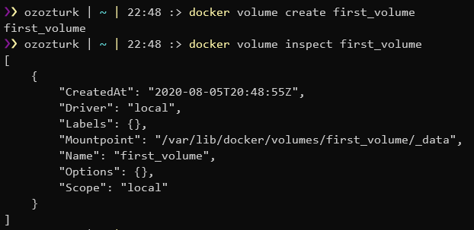
docker volume
docker volume create name
i.e: docker volume create first_volume

Slide 42
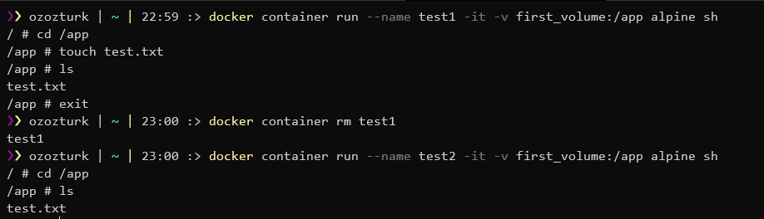
Volume mount
-v volumename-or-id : path-in-the-container
i.e: -v first_volume:/app

Slide 43
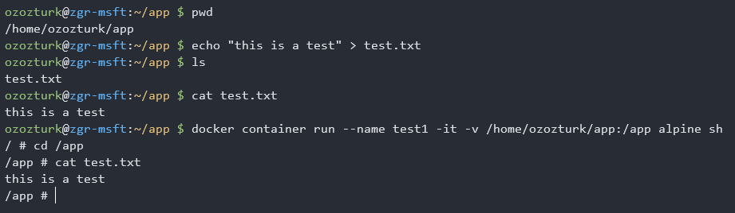
Bind Mount
-v path-on-the-host : path-on-the-container
i.e: -v /home/ozozturk/app:/app

Slide 44
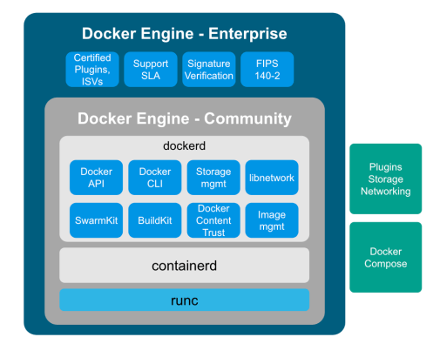
Docker’s magic
Although Docker consists of dozens of different services in the background and is infrastructurally complex, it does not offer a system other than what we used to know and know for years.

Slide 45
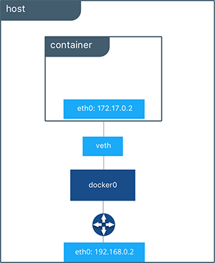
Docker Network Object

Slide 46
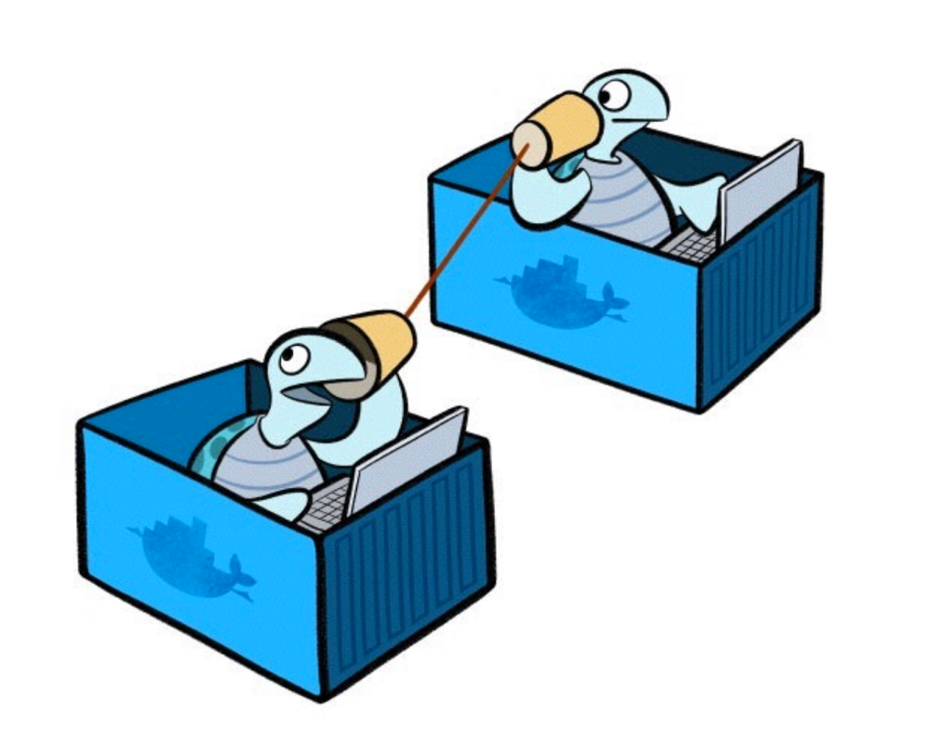
Docker Network Driver
Bridge
Host
Macvlan
None
Overlay

Slide 47
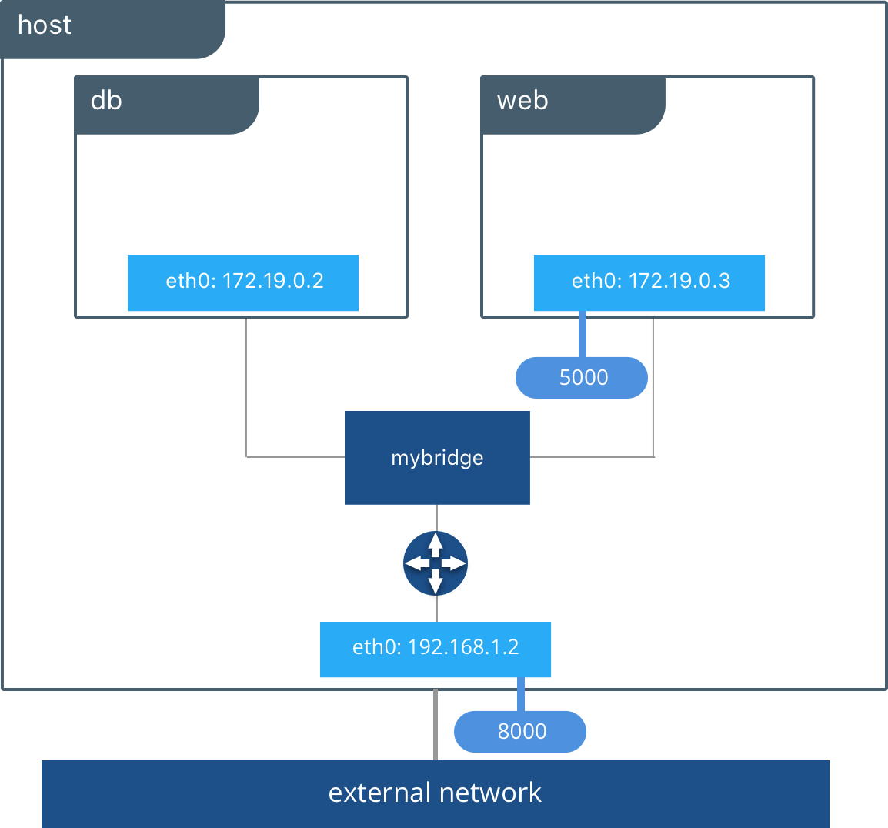
Bridge
Bridge is the default driver. When creating a network object, especially if no other driver is specified, the network is created with the bridge driver.
Each Docker installed host has a network called “Bridge” which is created with bridge driver and all the containers connect to this by default unless specified otherwise.

Slide 48
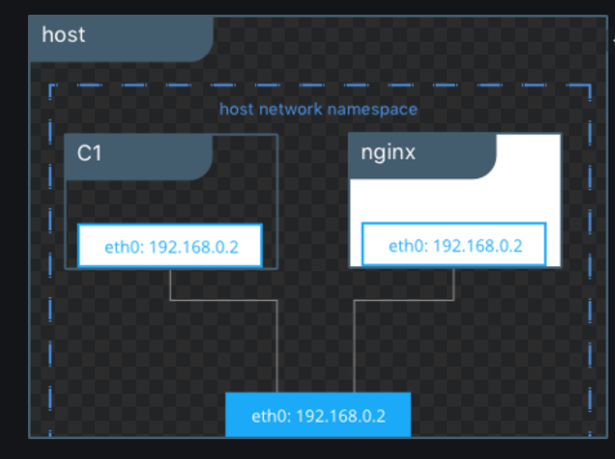
Host
Each Docker installed host has a network object named "Host" which is created with a host driver.
There is no network isolation between the host and the container which is connected to “host” network. Container uses the host's network resources like a process running on that host.

Slide 49
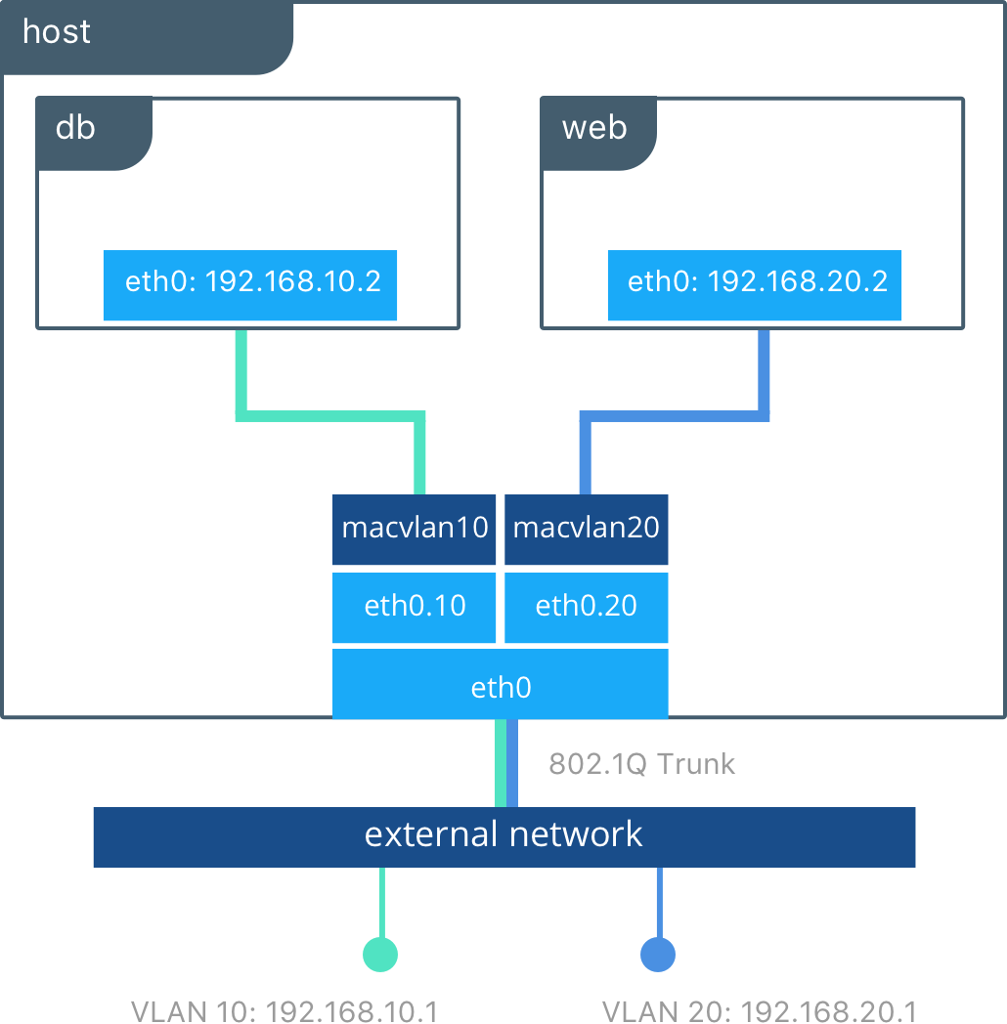
MacVlan
Thanks to the network objects created MacVlan driver, containers can be connected to physical networks as if they have a physical network adapter with their own mac address.

Slide 50

None
If the container is desired to have no network connection in any way, it must be connected to the network created with this driver.

Slide 51
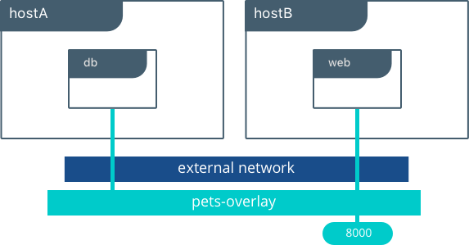
Overlay
The overlay network driver creates a distributed network among multiple Docker daemon hosts. This network sits on top of (overlays) the host-specific networks, allowing containers connected to it to communicate securely when encryption is enabled. Docker transparently handles routing of each packet to and from the correct Docker daemon host and the correct destination container.

Slide 52
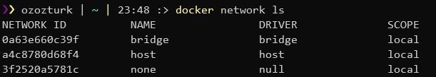
docker network
docker network ls

Slide 53
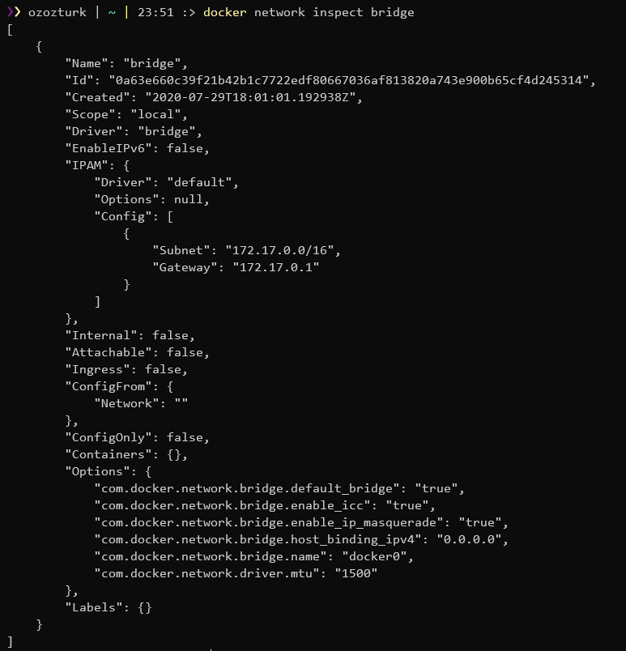
docker network
docker network inspect bridge

Slide 54
docker network
docker network create --driver driver-name network-name
i.e: docker network create --driver bridge first_network

Slide 55
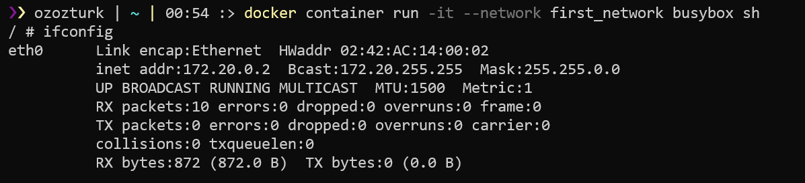
--network
docker container run --network network-name
i.e: docker container run --network first_network busybox

Slide 56
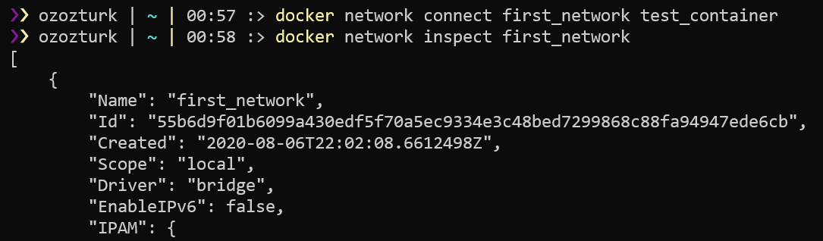
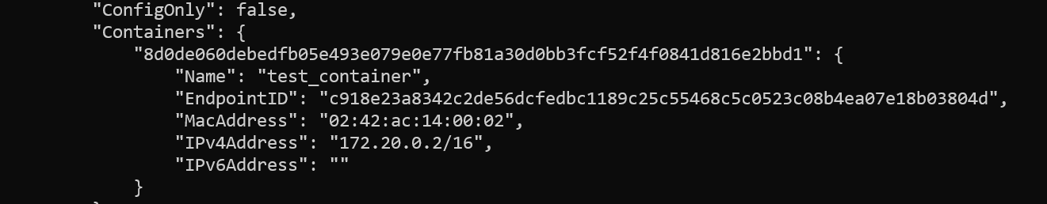
docker network connect
docker network connect network-name container-name
i.e: docker network connect first_network test_container

Slide 57

Port Publishing
80
5000
http://192.168.0.2:5000
client

Slide 58
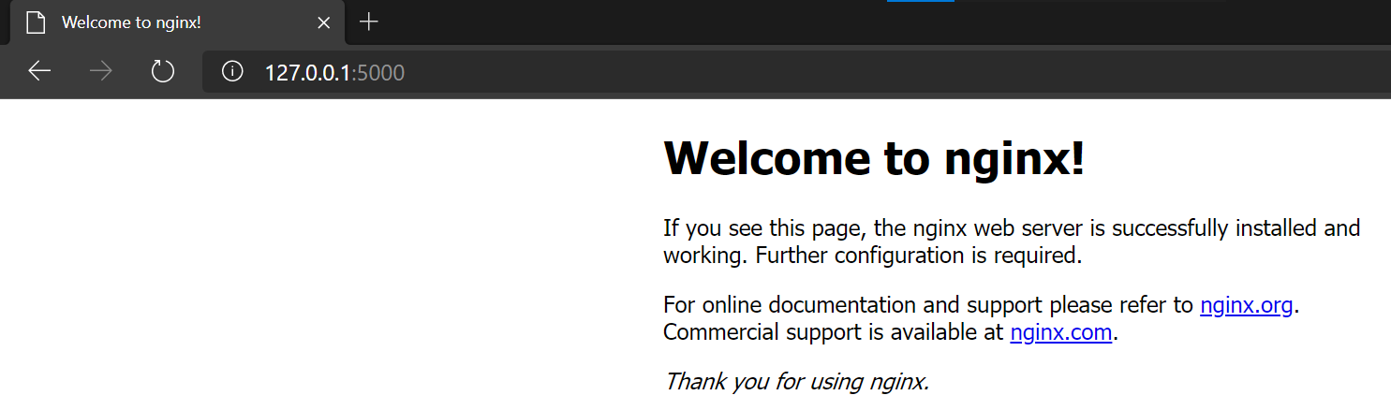
--publish | -p
docker container run --publish host-port:container-port/tcp-or-udp
i.e: docker container run -d --name webserver -p 5000:80 nginx

Slide 59
Challenge 3: Docker Objects
>
_
github.com/azuredevcollege/trainingdays/-> day6 -> Challenge 3

Slide 60

Image and Registry

Slide 61
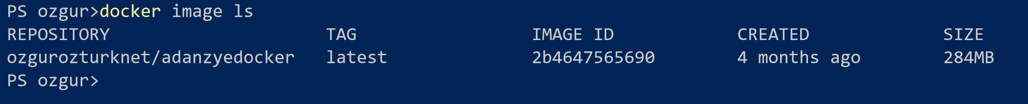
Docker Image ID

Slide 62
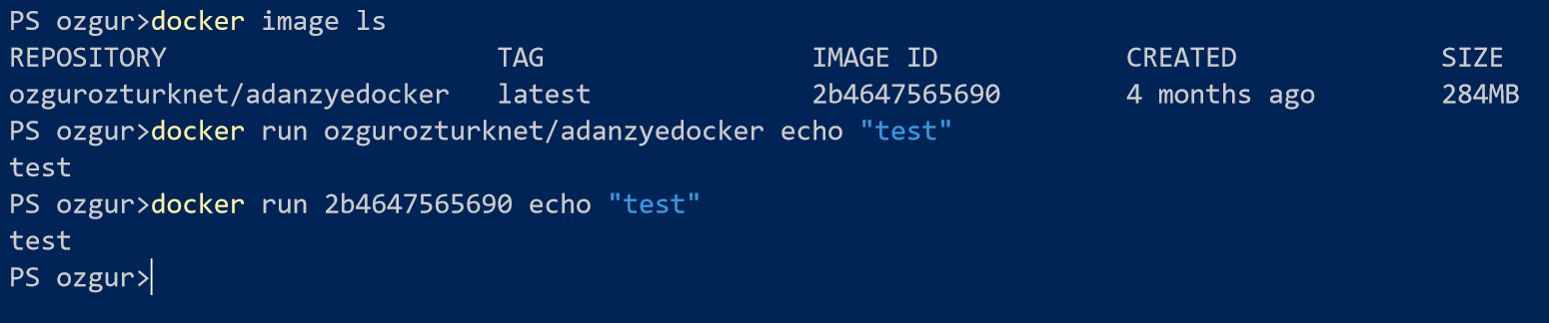
Docker Image ID

Slide 63
Docker Image Naming Scheme
ozgurozturknet/hello-app:latest
Names-Tags given to Docker Images
also indicates where that image is stored

Slide 64
Docker Image Names
docker.io/ozgurozturknet/hello-app:latest
hello-app
docker.io/ubuntu:18.04

Slide 65
Docker Image Names
docker.io/ozgurozturknet/hello-app:latest
Registry URL
Repository
Tag
docker.io/ubuntu:18.04
Registry URL
Repository
Tag

Slide 66
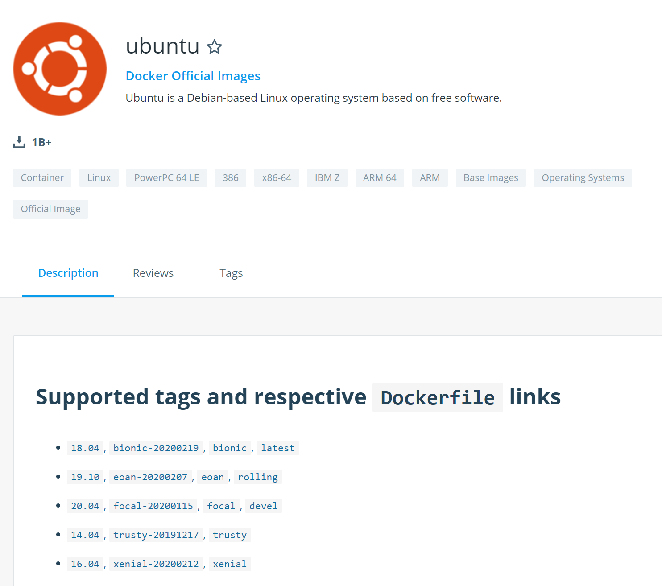
Image Tag
2 REPOSITORIES
1 REPOSITORY 2 TAG
ozgurozturknet/appdark
ozgurozturknet/applight
ozgurozturknet/app:dark
ozgurozturknet/app:light

Slide 67
Default Tag. Latest
ozgurozturknet/hello-app:latest
latest is the default tag in the Docker world.

Slide 68
Default Tag. Latest

Slide 69
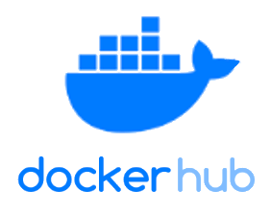
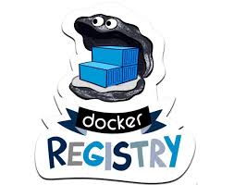



Docker Image Registry
Public Image Registry
Private Image Registry

Slide 70

docker image pull
docker image pull image_name:tag
i.e: docker image pull ubuntu:latest

Slide 71

docker image push
docker image push image_name:tag
i.e: docker image push ozgurozturknet/day6:latest

Slide 72

docker image build
docker image build –t image_repository:tag .
i.e: docker image build –t ozgurozturknet/hello-app:latest .

Slide 73

Dockerfile
Dockerfile is a file that is written in a language that has its own rules and allow us to create Docker Images.

Slide 74
FROM
FROM image:tag
The FROM instruction initializes a new build stage and sets the Base Image for subsequent instructions. As such, a valid Dockerfile must start with a FROM instruction.
i.e.: FROM ubuntu:18.04

Slide 75
RUN
RUN command
The RUN instruction will execute any commands in a new layer on top of the current image and commit the results. The resulting committed image will be used for the next step in the Dockerfile.
i.e.: RUN apt-get update

Slide 76
WORKDIR
WORKDIR /path
The WORKDIR instruction sets the working directory for any RUN, CMD, ENTRYPOINT, COPY and ADD instructions that follow it in the Dockerfile. If the WORKDIR doesn’t exist, it will be created even if it’s not used in any subsequent Dockerfile instruction.
i.e.: WORKDIR /usr/src/app

Slide 77
COPY
COPY source destination
The COPY instruction copies new files or directories from <src> and adds them to the filesystem of the container at the path <dest>.
i.e.: COPY /source /user/src/app

Slide 78
EXPOSE
EXPOSE port
The EXPOSE instruction informs Docker that the container listens on the specified network ports at runtime. You can specify whether the port listens on TCP or UDP, and the default is TCP if the protocol is not specified.
i.e.: EXPOSE 80/tcp

Slide 79
CMD
CMD command
There can only be one CMD instruction in a Dockerfile. If you list more than one CMD then only the last CMD will take effect.
The main purpose of a CMD is to provide defaults for an executing container. These defaults can include an executable, or they can omit the executable, in which case you must specify an ENTRYPOINT instruction as well.
i.e.: CMD java merhaba

Slide 80
HEALTHCHECK
HEALTHCHECK command
The HEALTHCHECK instruction tells Docker how to test a container to check that it is still working. This can detect cases such as a web server that is stuck in an infinite loop and unable to handle new connections, even though the server process is still running.
i.e: HEALTHCHECK --interval=5m --timeout=3s CMD curl -f http://localhost/ || exit 1

Slide 81
Dockerfile Sample
FROM ubuntu:18.04
COPY . /app
RUN make /app
CMD python /app/app.py

Slide 82
Dockerfile Sample
# Using official python runtime base image
FROM python:2.7-alpine
# Set the application directory
WORKDIR /app
# Install our requirements.txt
ADD requirements.txt /app/requirements.txt
RUN pip install -r requirements.txt
# Copy our code from the current folder to /app inside the container
ADD . /app
# Make port 80 available for links and/or publish
EXPOSE 80
# Define our command to be run when launching the container
CMD ["gunicorn", "app:app", "-b", "0.0.0.0:80", "--log-file", "-", "--access-logfile", "-", "--workers", "4", "--keep-alive", "0"]

Slide 83
Dockerfile Sample
FROM buildpack-deps:stretch
RUN groupadd --gid 1000 node \
&& useradd --uid 1000 --gid node --shell /bin/bash --create-home node
ENV NODE_VERSION 13.6.0
RUN ARCH= && dpkgArch="$(dpkg --print-architecture)" \
&& case "${dpkgArch##*-}" in \
amd64) ARCH='x64';; \
ppc64el) ARCH='ppc64le';; \
s390x) ARCH='s390x';; \
arm64) ARCH='arm64';; \
armhf) ARCH='armv7l';; \
i386) ARCH='x86';; \
*) echo "unsupported architecture"; exit 1 ;; \
esac \
# gpg keys listed at https://github.com/nodejs/node#release-keys
&& set -ex \
&& for key in \
94AE36675C464D64BAFA68DD7434390BDBE9B9C5 \
FD3A5288F042B6850C66B31F09FE44734EB7990E \
71DCFD284A79C3B38668286BC97EC7A07EDE3FC1 \
DD8F2338BAE7501E3DD5AC78C273792F7D83545D \
C4F0DFFF4E8C1A8236409D08E73BC641CC11F4C8 \
B9AE9905FFD7803F25714661B63B535A4C206CA9 \
77984A986EBC2AA786BC0F66B01FBB92821C587A \
8FCCA13FEF1D0C2E91008E09770F7A9A5AE15600 \
4ED778F539E3634C779C87C6D7062848A1AB005C \
A48C2BEE680E841632CD4E44F07496B3EB3C1762 \
B9E2F5981AA6E0CD28160D9FF13993A75599653C \
; do \
gpg --batch --keyserver hkp://p80.pool.sks-keyservers.net:80 --recv-keys "$key" || \
gpg --batch --keyserver hkp://ipv4.pool.sks-keyservers.net --recv-keys "$key" || \
gpg --batch --keyserver hkp://pgp.mit.edu:80 --recv-keys "$key" ; \
done \
&& curl -fsSLO --compressed "https://nodejs.org/dist/v$NODE_VERSION/node-v$NODE_VERSION-linux-$ARCH.tar.xz" \
&& curl -fsSLO --compressed "https://nodejs.org/dist/v$NODE_VERSION/SHASUMS256.txt.asc" \
&& gpg --batch --decrypt --output SHASUMS256.txt SHASUMS256.txt.asc \
&& grep " node-v$NODE_VERSION-linux-$ARCH.tar.xz\$" SHASUMS256.txt | sha256sum -c - \
&& tar -xJf "node-v$NODE_VERSION-linux-$ARCH.tar.xz" -C /usr/local --strip-components=1 --no-same-owner \
&& rm "node-v$NODE_VERSION-linux-$ARCH.tar.xz" SHASUMS256.txt.asc SHASUMS256.txt \
&& ln -s /usr/local/bin/node /usr/local/bin/nodejs
ENV YARN_VERSION 1.21.1
RUN set -ex \
&& for key in \
6A010C5166006599AA17F08146C2130DFD2497F5 \
; do \
gpg --batch --keyserver hkp://p80.pool.sks-keyservers.net:80 --recv-keys "$key" || \
gpg --batch --keyserver hkp://ipv4.pool.sks-keyservers.net --recv-keys "$key" || \
gpg --batch --keyserver hkp://pgp.mit.edu:80 --recv-keys "$key" ; \
done \
&& curl -fsSLO --compressed "https://yarnpkg.com/downloads/$YARN_VERSION/yarn-v$YARN_VERSION.tar.gz" \
&& curl -fsSLO --compressed "https://yarnpkg.com/downloads/$YARN_VERSION/yarn-v$YARN_VERSION.tar.gz.asc" \
&& gpg --batch --verify yarn-v$YARN_VERSION.tar.gz.asc yarn-v$YARN_VERSION.tar.gz \
&& mkdir -p /opt \
&& tar -xzf yarn-v$YARN_VERSION.tar.gz -C /opt/ \
&& ln -s /opt/yarn-v$YARN_VERSION/bin/yarn /usr/local/bin/yarn \
&& ln -s /opt/yarn-v$YARN_VERSION/bin/yarnpkg /usr/local/bin/yarnpkg \
&& rm yarn-v$YARN_VERSION.tar.gz.asc yarn-v$YARN_VERSION.tar.gz
COPY docker-entrypoint.sh /usr/local/bin/
ENTRYPOINT ["docker-entrypoint.sh"]
CMD [ "node" ]

Slide 84
Challenge 4: Image and Registry
>
_
github.com/azuredevcollege/trainingdays/-> day6 -> Challenge 4

Slide 85

Azure Container Services

Slide 86

Azure services for your container needs

Slide 87

Container Instances
Easily run containers on Azure without managing servers

Slide 88

Web App for Containers (App Service)
Quickly create powerful cloud apps for web and mobile

Slide 89

Batch
Cloud-scale job scheduling and compute management

Slide 90

Azure Service Fabric
Develop microservices and orchestrate containers on Windows or Linux

Slide 91

Azure Red Hat OpenShift
Run fully managed OpenShift clusters, jointly operated with Red Hat

Slide 92

Azure Container Registry (ACR)
Store and manage container images across all types of Azure deployments

Slide 93

Azure Kubernetes Service (AKS)
Simplify the deployment, management, and operations of Kubernetes

Slide 94
Challenge 5: Azure Container Services
>
_
github.com/azuredevcollege/trainingdays/-> day6 -> Challenge 5

Slide 95
Challenge 6: Self-learning
>
_
github.com/azuredevcollege/trainingdays/-> day6 -> Challenge 6

Slide 96

Congrats! You made it!
Questions | Feedback?

